Slide 1
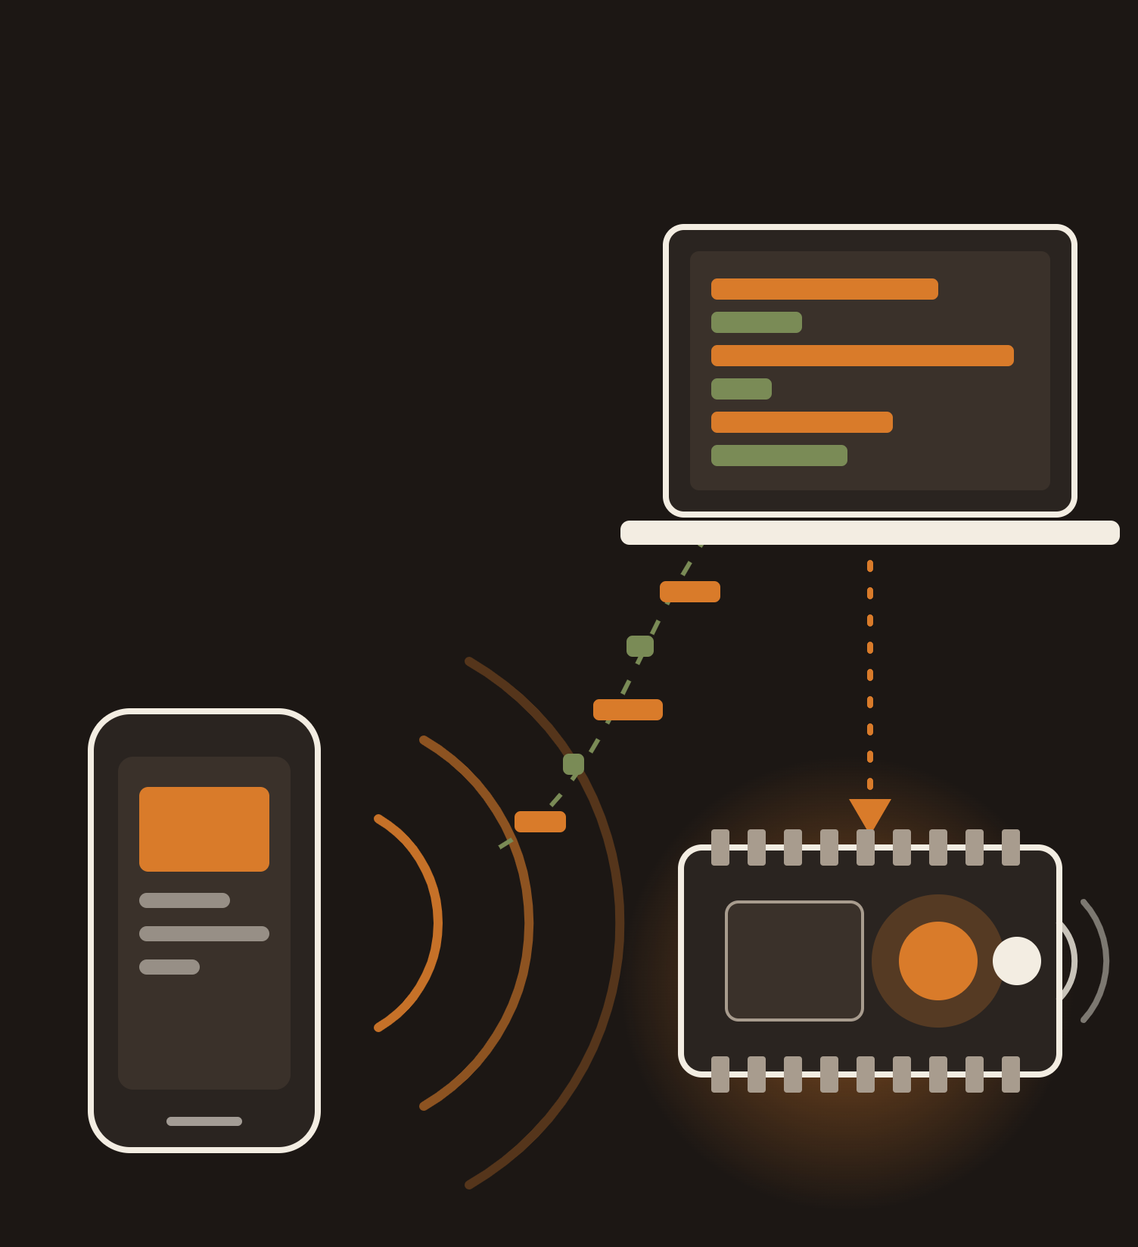
Net
Screen
ECE 422 · TERM PROJECT · UPDATE 1
New Jersey Institute of Technology
Hotspot laptop
Phone
Who is watching what on your Wi-Fi, without decrypting a single packet.
Team
Dorukhan Cakir · Asmar Hasanova · Yusuf Bilal Cetinkaya · Semih Karaismailoglu
ESP32 alert
Notes:
~1 min. Hi, we are team NetScreen. Our project answers one question: can we tell which app a phone is using (YouTube, TikTok, Instagram, Netflix, a game) just by looking at its Wi-Fi traffic, even when that traffic is fully encrypted? We then use that to track screen time per device and trigger an ESP32 alert when a limit is exceeded. Nothing is installed on the phone; everything happens at the network level.

Slide 2



Screen time, measured from the Wi-Fi
WHAT IS NETSCREEN
Nothing installed on the phone. We only look at the shape of its encrypted traffic.
Which app?
How long?
Over the limit?
YouTube, TikTok, Netflix, games
A running clock per phone, per app
Say 60 min of video a day. Past that, the ESP32 beeps
Notes:
~1 min. So what is NetScreen in plain words? It is a screen-time monitor that lives in the network instead of on the phone. Phones join our Wi-Fi hotspot. We never read the content of the traffic, which is encrypted anyway; we only look at its shape: how big the packets are and how they are spaced in time. From that, NetScreen identifies which app each phone is using, keeps a clock per device and per app, and when a limit is passed it sends an MQTT message to an ESP32 that lights up and beeps. Think of it as a parental-control router that works even when the app or a VPN tries to hide.

Slide 3
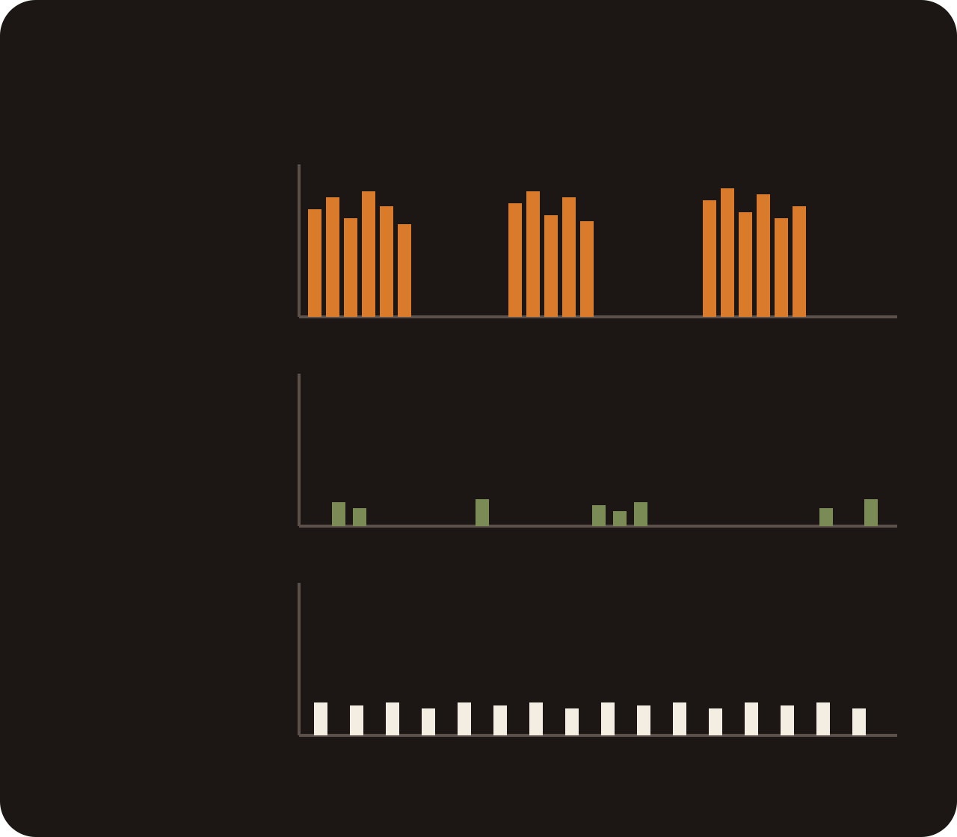
Encryption blinded the old way of spotting apps
WHY IT MATTERS
Routers used to read the domain name. DoH, QUIC and VPNs now hide it. Packet sizes and timing cannot be hidden, so that is what we classify, the same way Cisco Encrypted Traffic Analytics does.
What the network sees: packet size over time
tall bar = big packet · gap = silence
Video
YouTube, TikTok, Netflix
Three ways to tell which app a phone is using, in three situations
How we find the app | Plain Wi-Fi | Encrypted DNS | VPN
Read the website name in DNS | Finds it | Fails | Fails
Read the server name in TLS | Finds it | Finds it | Fails
Packet sizes and timing (ours) | Finds it | Finds it | We will test
Messaging
WhatsApp, Instagram DM
Gaming
any online game
time
Content is encrypted. The shape is not.
Notes:
~1 min. Traditional app identification reads plain-text clues: DNS queries and the TLS server name. Browsers now use DNS-over-HTTPS, YouTube runs over QUIC, Encrypted Client Hello hides SNI, and a VPN hides everything. The clues disappear, but the need does not. Operators prioritize Zoom over downloads, companies block apps, parents limit TikTok. Cisco solves this with NBAR2 and Encrypted Traffic Analytics, which classify flows by packet sizes and timing without decrypting. The picture on the right is the whole idea: the content is locked, but video streams in big bursts, chat in tiny packets, games in a steady trickle. That shape is what we classify.

Slide 4
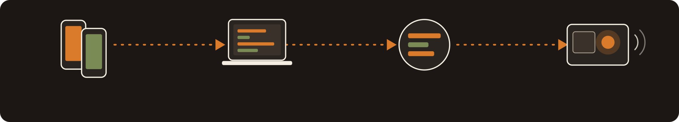

From packets to a buzzer
HOW AND WHEN
Phones on hotspot
Capture with tshark
Classify: DNS · SNI · ML
ESP32 alert via MQTT
our own devices only
grouped into flows, live dashboard
Random Forest, XGBoost, then 1D CNN
OLED screen, LED, buzzer. Stretch: standalone sniffer
Dataset
We measure
Oct 30
Nov 5
Nov 19
Dec 1 to 5
Dec 11
We record it ourselves: 10-minute sessions per app on our own phones. Labels are free. ISCX VPN-nonVPN as a public cross-check.
Accuracy per app, detection delay, false alarms. DNS vs SNI vs ML with DoH and VPN on. Features: packet sizes, inter-arrival times, burst length, up/down ratio.
500-word summary
Capture setup, labeled dataset
DNS/SNI baselines, ML model
DoH/VPN tests, ESP32 alert, demo video
Final report
Notes:
~1 min. The pipeline: phones connect to a laptop hotspot, we capture packets with tshark and group them into flows. Three classifiers run side by side: DNS-based, SNI-based, and an ML model that only sees packet sizes and inter-arrival times. For the ML model we start with Random Forest and XGBoost on hand-made flow features, which is usually enough, and then try a 1D CNN on raw packet-size sequences to see if it helps, especially under VPN. When a per-device limit is exceeded, an MQTT message makes the ESP32 light up and beep. We will report accuracy per app, detection latency and false alarms, and the core research question: how each method holds up when DNS-over-HTTPS or a VPN is turned on. Timeline: summary on Oct 30, dataset by Nov 5, baselines and model by Nov 19, encrypted-scenario tests and the ESP32 demo for the final presentation, report on Dec 11. If asked what accuracy we expect: based on published work on similar datasets, around 90 percent or higher for app category on plain Wi-Fi, roughly 80 to 95 percent for the exact app, about the same with encrypted DNS since the ML method never used DNS. Under a VPN we expect category-level accuracy in the 70 to 85 percent range and exact-app accuracy noticeably lower; that is the research question, and a low number there is still a valid result. We will report our own measured numbers at the third update. If asked what the ESP32 actually does: its main role is the physical alert, driven over MQTT, which is the standard IoT messaging protocol. The classification itself runs on the laptop. If time allows, we will also try the ESP32 as a standalone sniffer in Wi-Fi promiscuous mode: without joining the network or decrypting anything, it can see the size and timing of 802.11 frames in the air, which is exactly what our ML model uses. That would turn the alert device into an independent sensor, with the caveat that most ESP32 boards only see 2.4 GHz and drop some frames.

